Slide 1
WELCOME
THE BIGGEST global
HUMANITARIAN INITIATIVE EVER
TURNING SUFFERING AND TEARS INTO TRIUMPHS

Slide 2
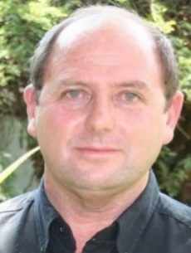
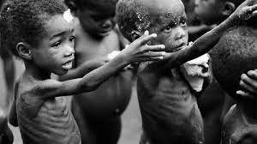
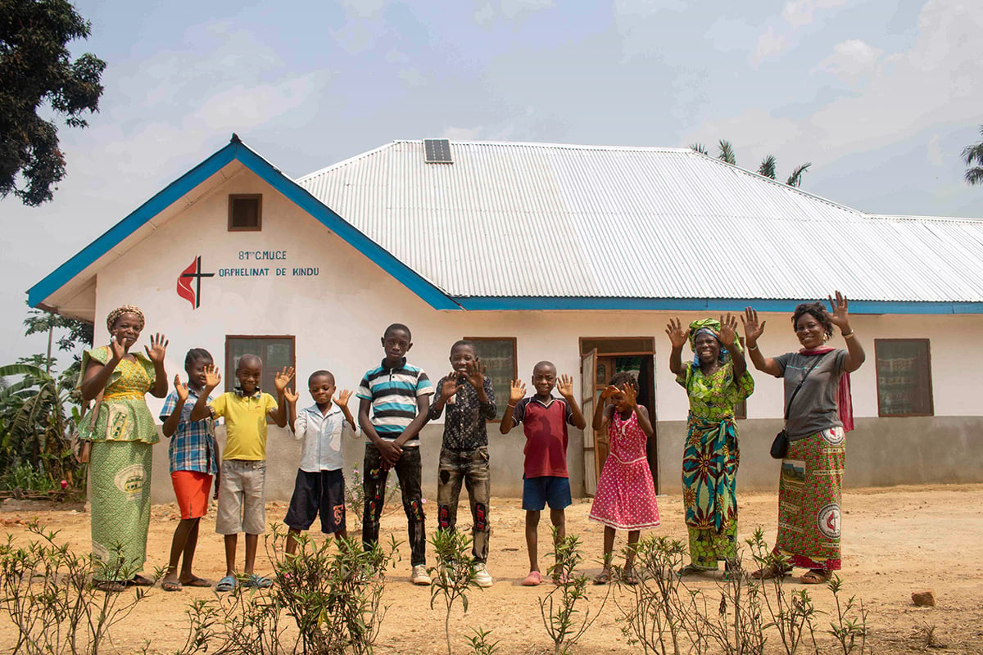
Founder
Dr Stefan Pienaar
Co-Founder
Adel Kotze
CHILD UPLIFTMENT
EDUCATION
CAUSES
BEING
SUPPORTED
EXTERNAL SERVICE PROVIDER
Wealth Creator 1 & 2
Prof Francois Engelbrecht
Training & Coaching
Modules to uplift everyone re.
Financial management skills etc
HUNGER
ORPHANAGES
HEAD: IT & WEB SERVICES
Dr Karien Smith

Slide 3
Why Helping Hearts ?
BEACON OF HOPE
GLOBAL COMMUNITY OF “CHANGE MAKERS”
MAIN FOCUS:
BREAK THE CYCLE OF POVERTY AND EXCLUSION
GIVE PEOPLE HOPE AND THEIR DIGNITY BACK
EVERYONE IN OUR SOCIETY DESERVES THIS “once in a lifetime” OPPORTUNITY
TOGETHER (AS A GLOBAL COMMUNITY) WE ARE STRONGER

Slide 4
WHAT MAKES HELPING HEARTS DIFFERENT
HH is an ingenious hybrid crowd-funding humanitarian project with a built in Donations Plan.
A project where NOBODY at the top is enriching themselves – there are No “Fat Cats” in HHI
The full contribution of $10 from members goes into the “fully automated” system as donations
Extremely sustainable project – no other platform like this
Helping Hearts is the first project globally that addresses the needs of the people at the bottom of society and will help them to a better life.
Millions of children to be helped into Education.
All balances restored through Helping Hearts:
Members will earn substantially, and
Millions of people will be helped out of poverty

Slide 5
HELPING HEARTS WILL HAVE ITS OWN INTERNATIONAL RADIO STATION – BROADCASTING INTO 180 COUNTRIES 24 HOURS A DAY
OUR RADIO STATION WILL BE KNOWN AS
HELPING HEARTS RADIO

Slide 6
3 INCOME STREAMS
IN HELPING HEARTS
NEW MEMBERS ENTER HERE
$10
Helping Hearts: 5 Phases
Wealth Creator 1: 3 Phases
Wealth Creator 2: 3 Phases
$250
$2500

Slide 7
DISCLAIMER
These projections you are about to see
are solely to illustrate
The scope and parameters of the
Donation plan within this crowd funding
(and fully automated) program.
They should NOT be misinterpreted
As claims, promises, or guarantees of
Income, earnings, or investment

Slide 8
HELPING HEARTS : Phase 1
Enter this phase with $10
Donation to you in this Phase
Surrounded by 39 HH Members
$ 192
Subtraction for Phase 2
$ 20
Distribution Fund (Free positions & Project X)
$ 60
$ 92
You Receive
Childcare, Education, Hunger, Orphanages & Rewards
$ 20

Slide 9
HELPING HEARTS : Phase 2
Enter this phase with $20
Donation to you in this Phase
Surrounded by 39 HH Members
$ 378
Subtraction for Phase 3
$ 150
Distribution Fund (Free positions & Project X)
$ 70
$ 128
You Receive
Childcare, Education, Hunger, Orphanages & Rewards
$ 30

Slide 10
HELPING HEARTS : Phase 3
Enter this phase with $150
Donation to you in this Phase
Surrounded by 39 HH Members
$ 3 060
Subtraction for Phase 4
$ 500
Distribution Fund (Free positions & Project X)
$ 230
Wealth Creator 1
$ 250
$ 1 570
You Receive
Childcare, Education, Hunger, Orphanages & Rewards
$ 510

Slide 11
HELPING HEARTS : Phase 4
Enter this phase with $500
Donation to you in this Phase
Surrounded by 39 HH Members
$ 9 690
Subtraction for Phase 5
$ 1000
Distribution Fund (Free positions & Project X)
$ 300
$ 6 090
You Receive
Childcare, Education, Hunger, Orphanages & Rewards
$ 2300

Slide 12
HELPING HEARTS : Phase 5
Enter this phase with $1000
Donation to you in this Phase
Surrounded by 39 HH Members
$20 760
Subtraction for Phase 1
$ 10
Distribution Fund (Free positions & Project X)
$ 660
$17 236
You Receive
Childcare, Education, Hunger, Orphanages & Rewards
$ 2854

Slide 13
WEALTH CREATOR: Phase 1
Enter this phase with $250
This position created from income in HH Phase 3
Donation to you in this Phase
Surrounded by 39 HH Members
$ 3 060
Subtraction for Phase 2
$2400
Distribution Fund (Free positions & Project X)
$ 300
Medical (TBA)
$ 500
$ 1 670
You Receive
Childcare, Education, Hunger, Orphanages & Rewards
$ 860

Slide 14
WEALTH CREATOR: Phase 2
Enter this phase with $2400
Donation to you in this Phase
Surrounded by 39 HH Members
$46 800
Subtraction for Phase 3
$ 5000
Distribution Fund (Free positions & Project X)
$ 8000
$23 200
You Receive
Childcare, Education, Hunger, Orphanages & Rewards
$ 10 600

Slide 15
WEALTH CREATOR: Phase 3
Enter this phase with $5000
Donation to you in this Phase
Surrounded by 39 HH Members
$105 000
Subtraction for Phase 1
$250
Distribution Fund (Free positions & Project X)
$ 15 000
$76 550
You Receive
Childcare, Education, Hunger, Orphanages & Rewards
$ 13 200

Slide 16
A 4th INCOME STREAM
An extra small portion will be put aside from the Distribution Account to create for members an extra income stream.
HH now looking for a company with investment accounts as well as one who has many members who can join Helping Hearts. This must be a win-win situation for the chosen company as well as for Helping Hearts.
No collaboration or partnership agreements will be signed with such an investment company. Only the members will participate, and money paid into their investment accounts that will be created by Helping Hearts.
This anticipated investment addition will be known as PROJECT X.
There will be NO ADDITIONAL COSTS for members to be included into this investment plan.
Nothing will be deducted from Helping Hearts incomes as indicated. So HH members will earn as they would have before this announcement.

Slide 17
The POWER of $10
Sustainability
2300 “Free”
Positions through
6 Phases

Slide 18
The POWER of a once-off
$10 contribution
And how it will impact MILLIONS of lives
and give people Hope again.
Helping Hearts – the biggest
Humanitarian initiative EVER

Slide 19
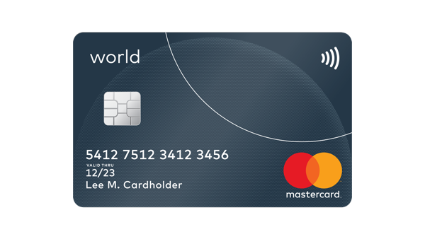
Crypto
Mastercard

Slide 20
TEMPORARY WEB REGISTRATION
As our system is being upgraded to a system that will accommodate the masses coming, we encourage all members to use the Web Registration Form described below for registration.
This is a temporary arrangement
INSTRUCTIONS:
Please purchase your E-Pins from authorized E-Pin dealers. One E-Pin = one position and = $10
There are Gas fees on transactions. These Gas fees differ from country to country and could be anywhere between $2 and $5. The E-Pin distributer will inform you of the Gas fee amount for your area / country.
Go to www.helpinghearts.biz and SCROLL TO THE BOTTOM OF THE PAGE.
There you will see a big white block with “CLICK HERE TO REGISTER”
Click on that and the Registration Form opens. Fill in all the fields.
COPY AND PASTE the E-Pin that you have purchased onto the Registration form and submit.
Immediately a confirmation notice will be sent to you that your information was received and is now in the database.
Unique “email address” and a unique “Username”

Slide 21
IMPORTANT DATES
We anticipate our system to be open for launch on or about
Monday, the 28th of October
and our formal launch to be on or about
Saturday, the 2nd of November

Slide 22
Crypto Tax Warning
Helping Hearts will not be liable for any of its members who are prosecuted for Crypto tax avoidance. Crypto laws differ from country to country and all Helping Hearts members must seek professional advice regarding the Crypto tax laws of the country they reside in.
PAY YOUR TAXES
and enjoy what is left without having to look over your shoulder.

Slide 23
Helping Hearts is our opportunity Today to create the Tomorrow we really want.
MANY PEOPLE AROUND THE WORLD WILL SEE THIS HONOURABLE MULTIPLE INCOME OPPORTUNITY AS WHAT THEY HAVE ALWAYS WANTED AND NEED NO MORE AFTER THIS. A PROGRAM THAT WILL HAVE NO LOSERS. ONLY WINNERS. MAKE THIS PROGRAM YOUR OWN AND LET’S BUILD HELPING HEARTS TO THE BIGGEST HUMANITARIAN INITIATIVE EVER. WE CAN DO IT !!!
Everyone will earn!!
Greetings from the Senior Executive Team

