Slide 1
Value Added Solutions
GROCERY
COUPONS

Slide 2
Lifestyle Services
GROCERY COUPONS
Help your members stretch their monthly budgets.
Our mobile grocery coupons offers savings on 50 items
which can be redeemed 5 times each month
Members receive a WhatsApp or SMS with a link to a white labelled coupon platform.
The service can be positioned as a tangible benefit of cost savings, which saves the member money which effectively decreases the cost of your services.

Slide 3
Accident Guardian
SERVICES COUPONS – SAMPLE SAVINGS
Save R100 every time purchasing these staple items
Coupons are redeemable at Checkers, Checkers Hyper and Shoprite Stores nationwide

Slide 4
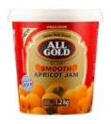
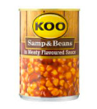
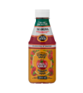
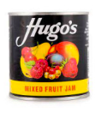
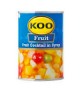
COUPONS – SAMPLE SELECTION
Condiments and
Sauces
Spreads
Canned Goods
R5.00 Off
R5.00 Off
R10.00 Off
R10.00 Off
R3.00 Off
R3.00 Off
R5.00 Off
R5.00 Off
R5.00 Off
R3.00 Off
R3.00 Off
R3.00 Off
Over 500 items to choose from

Slide 5
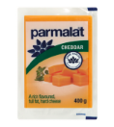
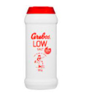
COUPONS – SAMPLE SELECTION
Frozen Food
Dairy and Desserts
Pantry
R10.00 Off
R20.00 Off
R10.00 Off
R10.00 Off
R10.00 Off
R10.00 Off
R10.00 Off
R20.00 Off
R20.00 Off
R3.00 Off
R10.00 Off
R3.00 Off
50 coupons per month that can each be redeemed 5 times

Slide 6
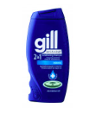
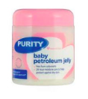
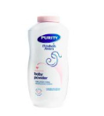
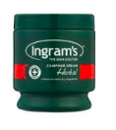
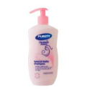
COUPONS – SAMPLE SELECTION
Household
Personal Care
Baby
R5.00 Off
R5.00 Off
R5.00 Off
R10.00 Off
R5.00 Off
R3.00 Off
R20.00 Off
R5.00 Off
R3.00 Off
R10.00 Off
R5.00 Off
R3.00 Off
We always include staple products, with the cost saving members can often afford some of the non-essential items

Slide 7
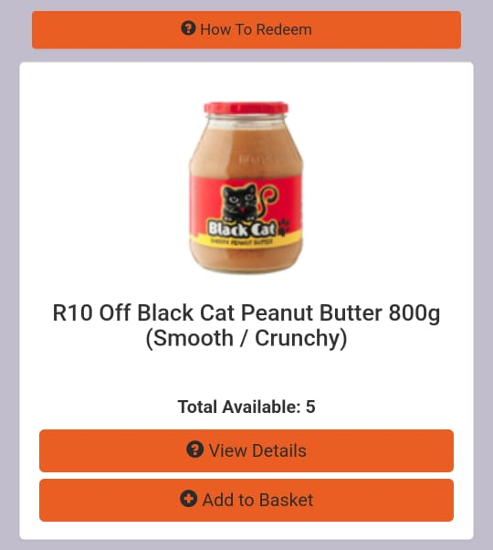
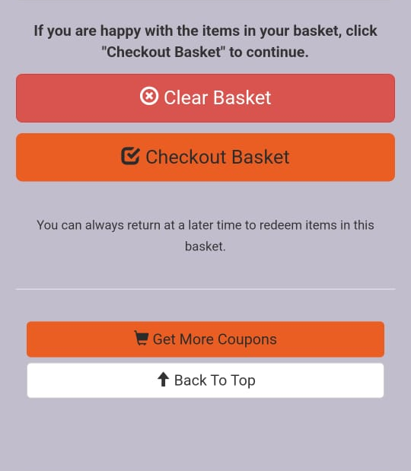
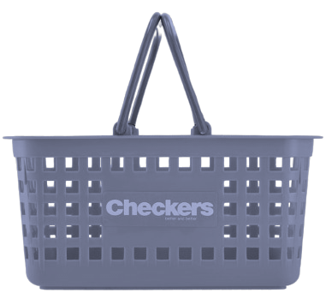
Accident Guardian
HOW IT WORKS
1
5
Show the code to the teller at point of sale and the discounts are deducted from the total basket value.
2
3
4

Slide 8
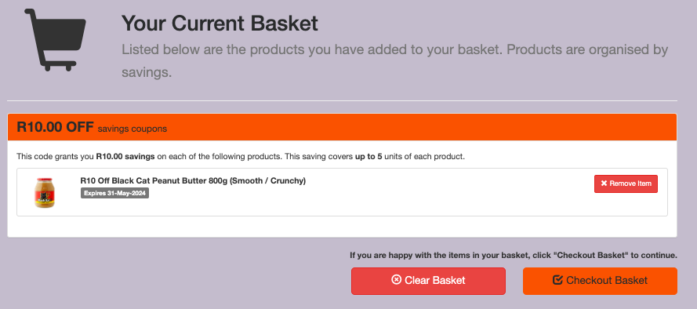
Accident Guardian
HOW IT WORKS
It is important to ensure that the correct brand and product size is purchased to earn the discount. Members can easily refer to the basket page and use this as a shopping list in store

Slide 9
Value Added Solutions
FEELBETTERFAST
PHARMACY VOUCHERS

Slide 10
Feel Better Fast
GIVE YOUR CUSTOMERS THE
VALUE OF PROFESSIONAL
MEDICAL SUPPORT
The majority of South Africans have no access to
medical aid or insurance. For many, private medical
care is difficult and costly to access.
FeelBetterFast puts professional healthcare into the hands of anyone with a mobile phone.
FeelBetterFast, is a digital voucher service for minor aliments
that utilises pharmacy-based professionals to provide a quick
and accessible treatment option for the management of
many minor alignments.
The FeelBetterFast service is redeemable by members
across a network of private pharmacies.

Slide 11
Medical Services
FEELBETTERFAST
Members receive quick and accessible treatment for the management of many minor health conditions.
These include:
Abdominal cramps
Constipations
Earache
Allergic skin rash
Cough
Fever
Athlete's foot
Cuts & Grazes
Hay fever
Backache
Diarrhea
Headaches
Blocked/runny nose
Dyspepsia (heartburn, indigestion)
Conjunctivitis
Head lice
Insect bites and stings
Muscle sprains
Nausea and vomiting
Nosebleeds
Period pain
Pink eye
Ringworm
Scabies
Sinusitis
Sore throat
Toothache

Slide 12
FeelBetterFast
TREATMENT AND MEDICINE FORMULARY
The service is based on the Standard Treatment Guidelines (STG) and the Essential Medicine List (EML), which ties the ailment to an evidence based medicine choice. E.g.:
MINOR ALIGNMENT | PRODUCTS AVAILABLE ON THE FORMULARY | SUPPORTING INFORMATION (where applicable)
Abdominal cramps/ Stomach cramps | Hyoscine butylbromide, oral, 10mg 6 hourly for a maximum of 3 days | Symptomatic treatment if no cause/indication for referral if found
Allergic skin rash Urticaria | Chlorpheniramine, oral, 4mg 6-8 hourly. Calamine lotion, applied on the skin. | Causes drowsiness. Avoid the use of corticosteroids.

Slide 13
FeelBetterFast
Cold & Flu Season
During winter, vouchers can be redeemed for:
Cold and flu medicines for symptomatic relief
Flu Vaccination Service (preventative measure)
Vitamin Kit (immunity support)
COLD &
FLU
SEASON

Slide 14
FeelBetterFast
How do voucher holders book a clinic appointment?
1
2
3
4
5
6
Members are directed to the nearest network pharmacy
An electronic voucher is sent to the member on their cellphone
Members present the voucher to see the nurse or pharmacist
The nurse or pharmacist will screen for symptoms
Medication is provided
Call the Care Centre

Slide 15
FeelBetterFast
HEALTHCHECK
Voucher holders inform the pharmacist that they
are attending the clinic to conduct a Health
Check.
This includes:
Blood Pressure
Glucose Levels
Cholesterol
Smoking Status
Weight
The member will be provided with a report

